Slide 1

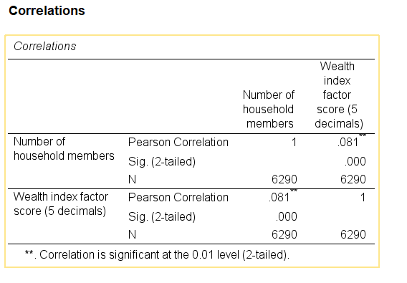
Relationship between number of household members and wealth index score
Presenter Name (contact information)
Grand Canyon University, Phoenix Arizona
Collage of Nursing and Health Care Professions
Introduction and Problem
Results
Discussion
Individuals across different parts of the world have different living standards categorized into low, medium and high-income levels. The level of commitment to understanding individual wellbeing presents a highly essential system that offers a better focus on crucial concepts that help understand individual wealth status (Egede et al., 2017).
The wealth index score provides a cumulative understanding of a household's living standards based on the integration of different measures. The different levels of living standards present a different approach, which helps define a different level emphasis under which it is easier to maintain a proper focus on individual development (Chakraborty et al., 2016). Low-income countries tend to have a very low wealthy index compared to high-income countries. This is mainly a result of different factors that present a highly specific consideration on critical aspects such as the average age of household heads, education attainment, and employment status (Duraiappah, 2018).
The wealth index encompasses different factors that can be assessed independently to help understand specific concepts that help in building an understanding of individual social and economic development within a given setting. Therefore this research focuses on establishing the underlying factors which influence the wealth index.
Research question : Is there significant relationship between number of household members and wealth index score?
Hypothesis (Ho): There is no statistically significant relationship between number of household members and wealth index score
The results have shown that the number of individuals with a given household is correlated with the wealth index factor score. This means that an increase in the number of household members is associated with a very small increase in the wealth index score. Therefore it is crucial to understand that the number of household members has a weak influence on the wealth index factor scale. Correlation analysis does not indicate causation.
Conclusions and Future Research
The findings from correlation analysis show that there is a positive weak, significant relationship between the number of household members and the wealth index factor score (r = 0.081, p= 0.000, p<0.05).
There is a weak relationship between the number of household members and the wealth index factor score. This means that it is important to focus on understanding whether the number of household members predict the wealth index score. It is also vital to understand different factors that statistically predict wealth index score.
Methods
The data utilized in this case was adopted from the Demographic and health survey, where a total of 6290 respondents were included in the survey. The variables that are included in the study include the wealth index and number of individuals in the household. Both variables are measured on a continuous scale.
Correlation analysis presents a better focus on the existing relationship between a number of individuals in a household and a wealth index score. Correlation analysis offers an understanding of the underlying direction and strength of how the two variables being investigated are linked.
References
Briones, K. (2017). 'How many rooms are there in your house?'Constructing the young lives wealth index.
Chakraborty, N. M., Fry, K., Behl, R., & Longfield, K. (2016). Simplified asset indices to measure wealth and equity in health programs: a reliability and validity analysis using survey data from 16 countries. Global Health: Science and Practice, 4(1), 141-154.
Duraiappah, A. (2018). The Inclusive Wealth Index: Measuring the Sustainability of the Sustainable Development Goals. In Ecology, Economy and Society (pp. 37-48). Springer, Singapore.
Egede, L. E., Voronca, D., Walker, R. J., & Thomas, C. (2017). Rural-Urban Differences in Trends in the Wealth Index in Kenya: 1993-2009. Annals of global health, 83(2), 248-258.

